Slide 1
Management 515
Motivation and Performance
© 2014 David E. Frick.
All rights reserved.

Slide 2
Classic Definitions
Motivation. The psychological forces that determine the direction of a person’s behavior in an organization, a person’s level of effort, and a person’s level of persistence
Explains why people behave the way they do in organizations
Can be manipulated by external forces
Nature of Motivation.
Direction. Possible behaviors the individual could engage in
Effort. How hard the individual will work
Persistence. Whether the individual will keep trying or give up when faced with obstacles
Notes:
Here are the classic descriptions of motivation. You will find definitions similar to these in most books on management.
I believe this description to be inaccurate.

Slide 3
My Definition
Motivation: An internal desire to elicit a pleasurable physiological response, i.e., the production of neurotransmitting hormones. This desire can be a consequence of a learned response to stimuli, the outcome of a logical assessment (an internal cost-benefit analysis), or the demand to satisfy some physical human need. It is the mildest form of addiction.
Notes:
View this video: https://www.youtube.com/watch?v=ReRcHdeUG9Y
This is a 45 minute video. Yes, that is a long video, but Mr. Sinek has done a very good job of capturing his book, “Why Leaders Eat Last,” in this video.
By watching this video, you do not need to buy and read his book.

Slide 4
More Definitions
Intrinsic Motivation.
Desire to take an action for it’s own sake
Usually results in a physiological response, e.g., production of endorphins or dopamine
Extrinsic Motivation. Desire to take an action in order to receive an external reward or avoid a punishment
Pro-social Motivation. Desire to benefit or help others
Philanthropy. Taking action to better mankind
Misanthropy. Hatred or distain of humankind or human nature
Charity. Taking action to alleviate suffering in others
Notes:
Two types of motivation exist: intrinsic (internal) and extrinsic (external).
In my view of the world, even extrinsic motivation is a precursor to a physiological response, i.e., you make a logical assessment that doing something will result in a dopamine response.
Pro-social motivation is a term used in many books on the topic of motivation. I do not consider this a separate category of motivation. In my view, philanthropic action (to better mankind) or charitable action (to alleviate suffering in one) is a logical assessment that the action is in the best interest of the individual—maximizing pleasure or minimizing harm.
Mentally healthy people act in their rational self interest. Mentally healthy people will not do things that cause them harm. I argue that even the exceptions are not exceptions.
The priest who accepts poverty, chastity, and humility to help others, in my mind is doing so because he is convinced that he will receive his reward in the afterlife.
The parent who risks life to save a child does so because of the logical assessment that the risk in action is less costly (harmful) than the harm of the death of the child.
Acts of generosity encourage the production of serotonin.

Slide 5
Relevant to Business
Inputs. Anything a person contributes to his or her job or organization, e.g., time, effort, skills, knowledge, work behaviors
Outputs. Anything a person gets from a job or an organization, e.g., pay, job security, benefits, praise or recognition, positive feedback
Benefits. Compensation other than salary
Total Pay Package. Total value of all monetary compensation and benefits
Notes:
These definitions of input and output are from the perspective of the employee.
From the firm’s perspective, the employee is a black box, into which you feed inputs (pay and benefits, instructions, policies) and from which the firm accepts outputs (work, ideas, or other actions).

Slide 6
Business Theories of Motivation
Expectancy Theory. Motivation will be high when workers believe that high levels of effort lead to high performance and high performance leads to achieving desired outputs or outcomes (Victor Vroom)
Three Needs Theory. Posits that the needs for achievement, power, and affiliation affect the actions of people from a managerial context (David McClelland)
Maslow’s Hierarch of Needs. A model of how human’s seek to satisfy needs at progressively higher levels. Needs at a lower level must be satisfied before seeking needs at a higher level (Abraham Maslow)
Notes:
You have seen the other two, so view this video on Three Needs Theory: https://www.youtube.com/watch?v=an5MW6F03wk

Slide 7
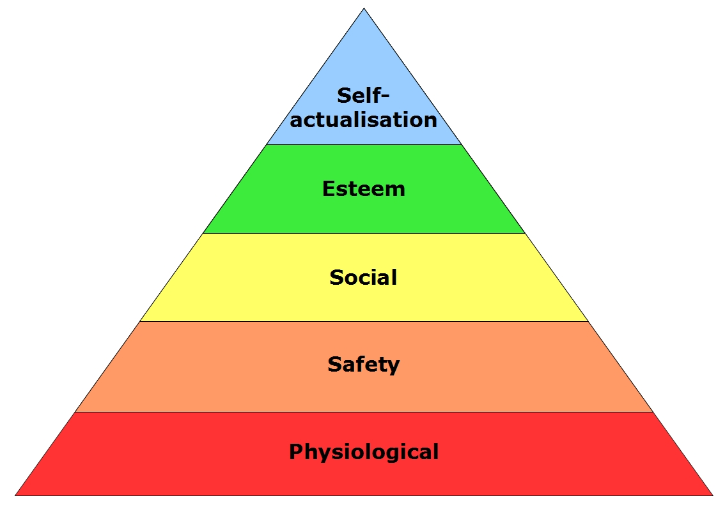
Notes:
Here is a popular model of Maslow’s Hierarchy of Needs.
If you need a refresher, view this 3 minute video: https://www.youtube.com/watch?v=EH04OsNuvcw

Slide 8
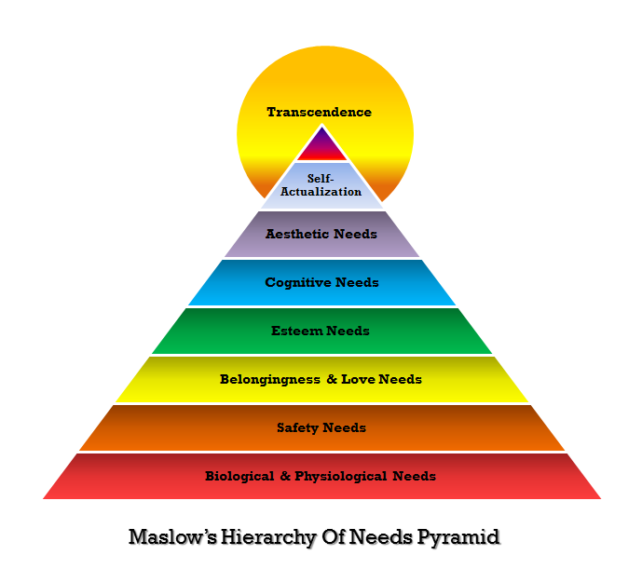
Maslow’s -- Another View
Notes:
Maslow’s original model actually had 8 levels. I read his book, “Maslow: On Motivation” and the distinction between the 8 and 5-level model is insignificant.
One point of trivia that I need to make on this topic. Almost all of the commenters of Maslow describe his Hierarchy of Needs as a theory. It is not.
A theory provides an explanatory framework for some observation, and from the assumptions of the explanation follows a number of possible hypotheses that can be tested in order to provide support for, or challenge, the theory.
The hierarchy cannot be decomposed into hypotheses that can be tested.
Is this distinction important? Probably not, but I prefer to be exact in presenting theses briefings.

Slide 9
More Business Theories of Motivation
ERG Theory. There exist three universal needs—existence, relatedness, and growth—which constitute a hierarchy of needs and motivate behavior (Clayton Alderfer)
Motivation-Hygiene Theory. Posits that some outcomes that lead to higher motivation and job satisfaction and can prevent dissatisfaction. Unsatisfied hygiene needs create dissatisfaction; satisfaction of hygiene needs does not lead to motivation or job satisfaction (Frederick Hertzberg)
Equity Theory. Workers constantly evaluate the fairness of their work outputs or outcomes with respect to their work inputs (Stacy Adams)
Notes:
Again, your have seen the other two, so look at this video on ERG Theory: https://www.youtube.com/watch?v=W_DH2YYO0qE

Slide 10
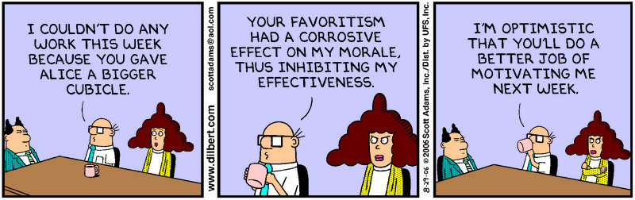
An Example of Equity Theory

Slide 11
More Business Theories of Motivation
Goal Setting Theory. Focuses on identifying the types of goals that are most effective in producing high levels of motivation and performance and explaining why goals have these effects (Edwin Locke)
Operant Conditioning Theory. People learn to perform behaviors that lead to desired consequences and learn not to perform behaviors that lead to undesired consequences
Positive Reinforcement. Offer people outcomes they desire when they exhibit desired behaviors (get a cookie)
Negative Reinforcement. Eliminate or remove undesired outcomes when people exhibit desired outcomes (stop the beatings) (B.F. Skinner)

Slide 12
More Business Theories of Motivation
Motivation Crowding Theory. Extrinsic motivators such as monetary incentives or punishments can undermine intrinsic motivation (Bruno Fey & Reto Jegen)
Self-determination Theory. A self-determined man chooses to behave in a manner that reflects his autonomy and his behavior and not to achieve an external reward or escape aversive environmental stimuli (Edward Deci & Richard Ryan)
Tournament Theory. Large differences between pay of a superior and subordinate motivates subordinates to compete for the reward (Edward Lazear & Sherwin Rosen)
Notes:
View this video on Self-determination Theory: https://www.youtube.com/watch?v=pskp2rZ94RQ
The effects of Tournament Theory is most common in professional athletics, where you see the best in a specific area (who might only be slightly better than the next person) can demand huge salaries differences.
Look at CEO salaries. Men and women are given huge salaries because they are perceived to be the best and therefore demand tournament-like salaries. Even worse, the benefit packages usually include “golden parachutes” where the executive is paid a huge bonus, when the executive leaves the firm. So even if the executive does a poor job, destroys the company, and is fired, a huge bonus is received.

Slide 13
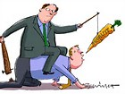
If you must punish…
Downplay the personal element of punishment. Make it clear that you are dissatisfied with the performance or dysfunctional behavior, not the person
Try to punish dysfunctional behaviors as soon after they occur. Be certain that individuals know exactly why they are being punished
Try to avoid punishing someone in front of others. This can damage a person’s self-esteem. However, making organizational members aware that an individual who has committed a serious infraction has been punished is effective in preventing future infractions
Notes:
The "carrot and stick" approach is an idiom that refers to a policy of offering a combination of rewards and punishment to induce behavior. It is named in reference to a cart driver dangling a carrot in front of a mule and holding a stick behind it.
If you are in a position to apply the stick, such must be done carefully.

Slide 14
Pay and Motivation
Expectancy Theory. Instrumentality, the association between performance and outcomes, must be high for motivation to be high
Needs Theory. Pay is used to satisfy many needs
Equity Theory. Pay is given in relation to inputs
Goal Setting Theory. Pay is linked to attainment of goals
Maslow. Once basic needs are satisfied, pay becomes less influential in motivating performance
Notes:
View this video: http://www.ted.com/talks/dan_ariely_what_makes_us_feel_good_about_our_work

Slide 15
Merit Pay
Bonuses. Compensation plan that bases pay on individual, group, or organization performance
Piece-rate Pay. Employee’s pay is based on the number of units that the employee produces
Commission Pay. Employee’s pay is based on a percentage of sales that the employee makes
Organizationally-based Merit Plans
Scanlon plan. Focuses on cost avoidance (reducing expenses or costs) and sharing based on savings
Profit sharing. Employees receive a share of an organization’s profits
Notes:
Bonuses are a common form of contingent, extrinsic rewards: do this and get this.
Piece rate pay is the ultimate form on incentive. Amazingly, advocates for workers rights have denounce piece rate pay as exploitative.

Slide 16
One PhD’s View
Equity and Expectancy. As long as pay is considered equitable and meets expectations, pay is not a motivator. It can, however, be a dissatisfier (Motivation-Hygiene Theory) when perceived as unfair or unexpected
Merit Pay. All pay-for-performance plans, except pure piece work, will be considered unfair and inequitable by some and have a net negative result on the firm. Pure piece work is considered exploitative
Pay is never #1. Pay has never ranked higher than 8th on any list of factors that motivate performance

Slide 17
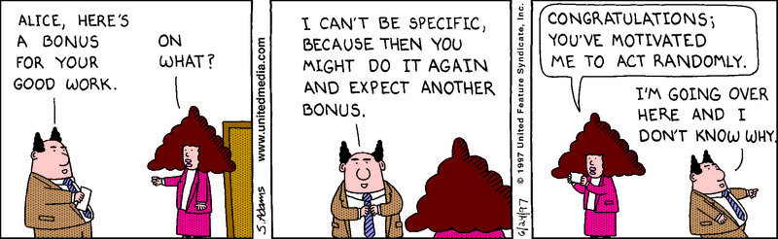
Alternate View Continued
Extrinsic rewards, if used, must be trivial, timely, and directly linked to the desired behavior

Slide 18
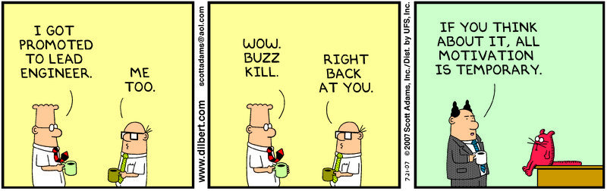
Alternate View Continued
Motivational tricks, e.g., new titles without increases in pay or responsibility, don’t fool anyone

Slide 19
The World is Changing
Knowledge workers. Value to firm is based on knowledge held by individual not on skills
Industrial to service-oriented. The United States is becoming a pure service-oriented workforce
Developing nations. Lesser developed nations can provide labor at lower costs
Communication costs. Communication transaction costs continue to decrease
Notes:
View this video: http://www.ted.com/talks/dan_pink_on_motivation

